Slide 1

Plantillas CONTOSO

Slide 2
Iconos

Slide 3


Slide 19




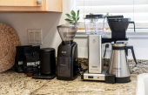


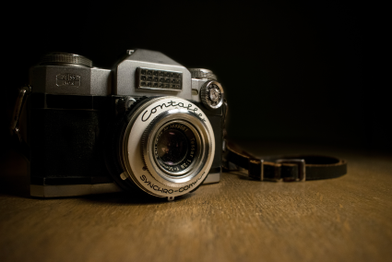

Slide 20














Slide 21

Logos

